Slide 1





IBEX-lo 2015 Ops and ISN Overview
D. Heirtzler, A. Galli, K. Fairchild, H. Kucharek, T. Leonard,
E. Möbius, M.Quinn, N. Schwadron

Slide 2
2015 IBEX-Lo Overview
Overall Operations
  IBEX has operated nominally during 2015 (so far)
    No abnormal HV behavior, PAC stable @ 7kV
    MCP responsiveness remains effectively unchanged from previous years.
    One incident of “Orange” space weather conditions did not adversely effect the instrument.
    The IBEX-lo low voltage current monitor follows count rates and is an indicator for strong SEP events as well as normal high backgrounds.
  Planning has begin for remainder of 2015/2016

Slide 3
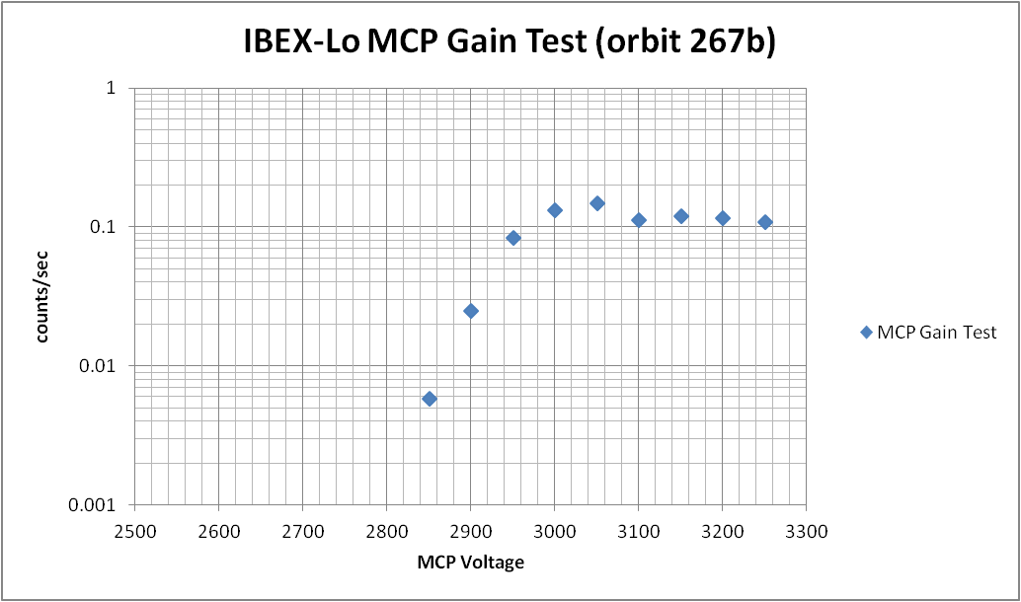
IBEX-Lo MCP Gain testing
Last run in orbit 267b
  Results normal, no indication of gain loss
This year’s gain test planned for Orbit 309 higher than 15 R_{e}

Slide 4
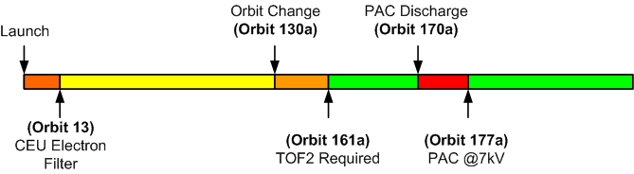
IBEX-Lo Maps
Currently there are 3 Map corrections
  Geometric Correction
  Bootstrap Correction
  Oxygen Sputtering Correction
Only 2 and 3 are implemented in the 5 year and trial 7 year maps.
Different corrections needed for different phases of the mission:

Slide 5
ISN Goodtimes List
The ISN goodtimes list has been updated through orbit 279a
  Orbit 9-26 (2009)
  Orbit 54-75 (2010)
  Orbit 102-123 (2011)
  Orbit 147a-160b (2012)
  Orbit 193a-198b (2013)
  Orbit 233b-239a (2014)
  Orbit 271b-279a (2015)
ISN goodtimes expanded to include Warm Breeze Orbits

Slide 6
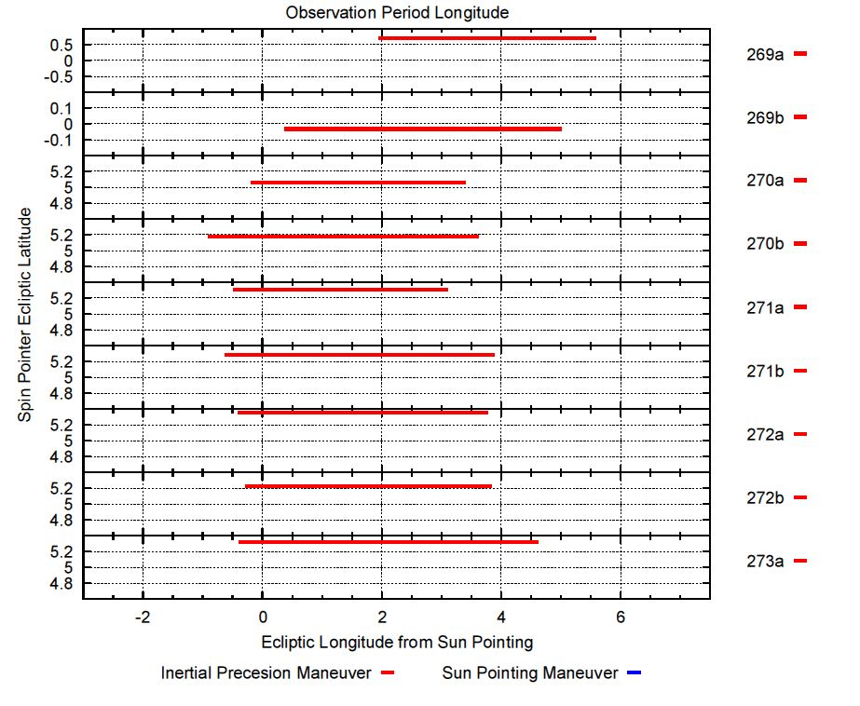
2015 ISN Season Pointing (1/3)

Slide 7
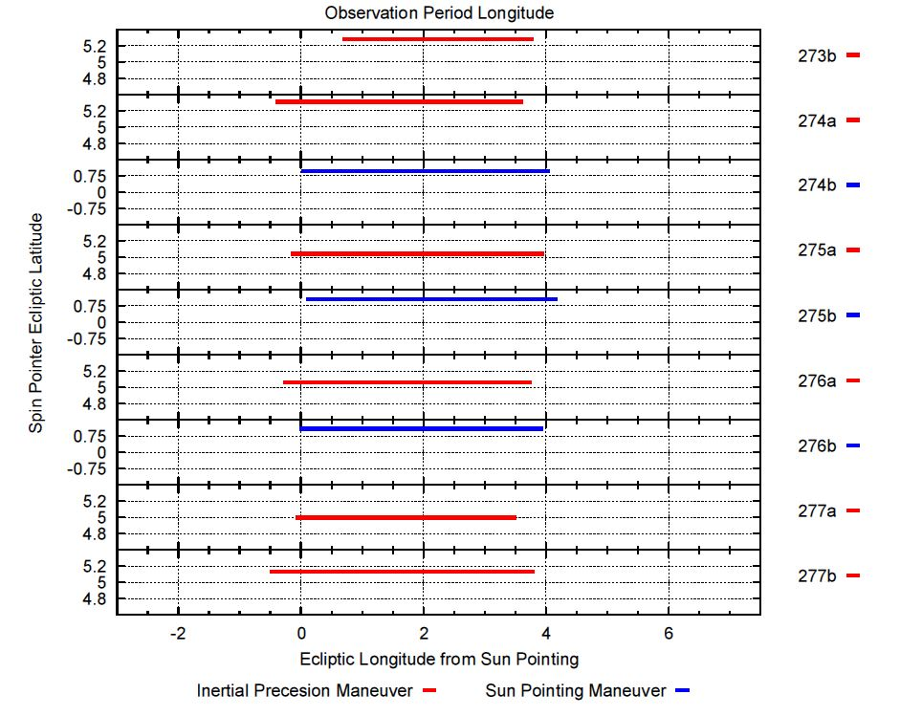
2015 ISN Season Pointing (2/3)

Slide 8
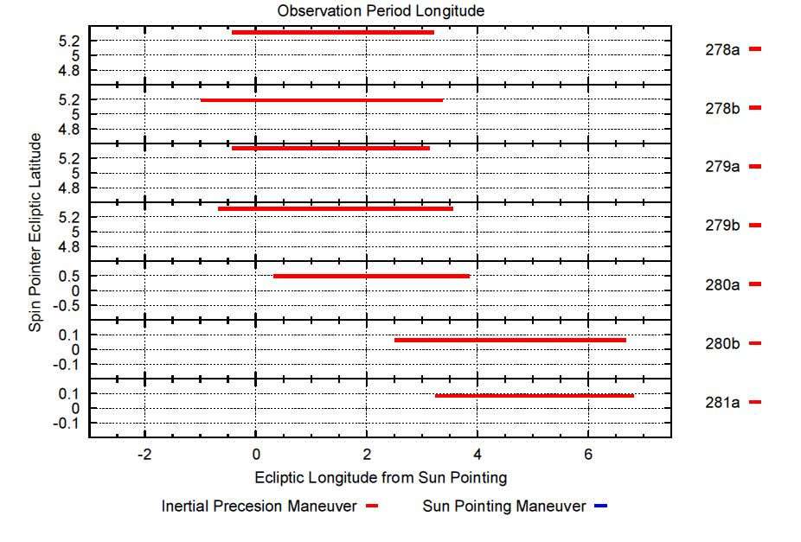
2015 ISN Season Pointing (3/3)

Slide 9
ISN 512spin Data Products (1/5)
For periods within the ISN goodtimes:
  Accumulated direct event data that meet the following criteria:
    Golden triples
    “Hydrogen” time-of-flight
    Energy Steps 1-3 are included during non-special mode periods.
  Histogram bin data coincident with direct event times above, accumulated into 512 spin periods (approx 2 hours)

Slide 10
ISN 512spin Data Products (2/5)
ISN data products:
  For each contiguous time in the ISN goodtimes list:
    1 row for each of the 60 6° anguar bins indicating the center angle for a given bin
    Start time for each 512 spin period (GPS time)
    End time for each 512 spin period (GPS time)
    Total accumulation time (sanity check)
    Histogram counts for each angular bin
    Direct Even counts for each angular bin
  Data files are in comma separated value (csv) format

Slide 11
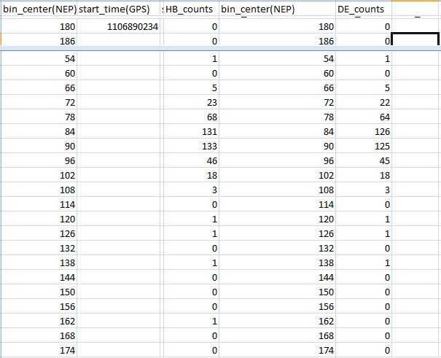
ISN 512spin Data Products (3/5)
ISN data product sample:
GPS
Start time
angular bin
center
(sanity check)
angular bin
center
direct event
counts
histogram
bin counts

Slide 12
ISN 512spin Data Products (4/5)
ISN data product QA checks:
  All ISN season orbits are checked for contaminating backgrounds around the ISN peak itself. Times with high backgrounds are eliminated.
    Background threshold for this test is determined orbit by orbit using sample quiet times.
    Times when the TOF 2 rate exceeds this background by 60% are excluded.
    Times with spin issues are excluded
    Times with special operations are excluded (gain tests, etc…)
  Remaining times are included in ISN data products
  Resulting ISN data products are checked for continuity (time and angle), and suppression (loss of direct events due to instrument throttling).

Slide 13
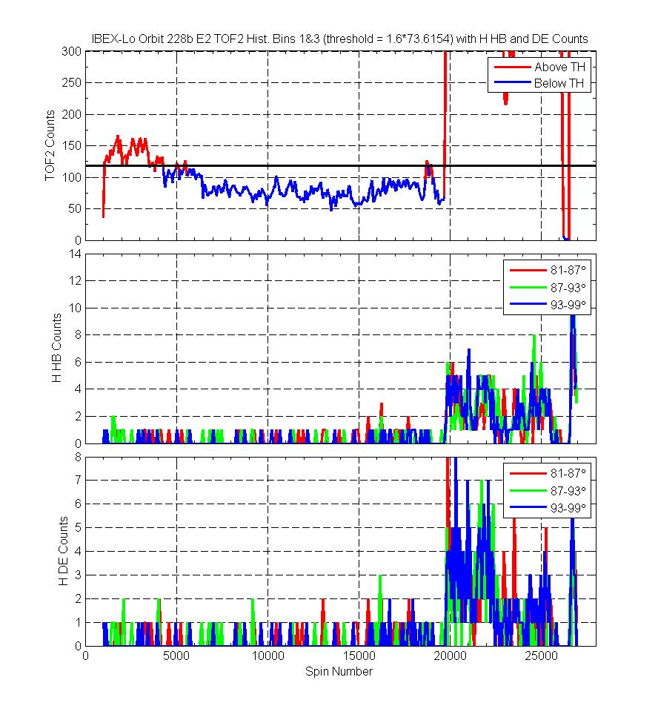
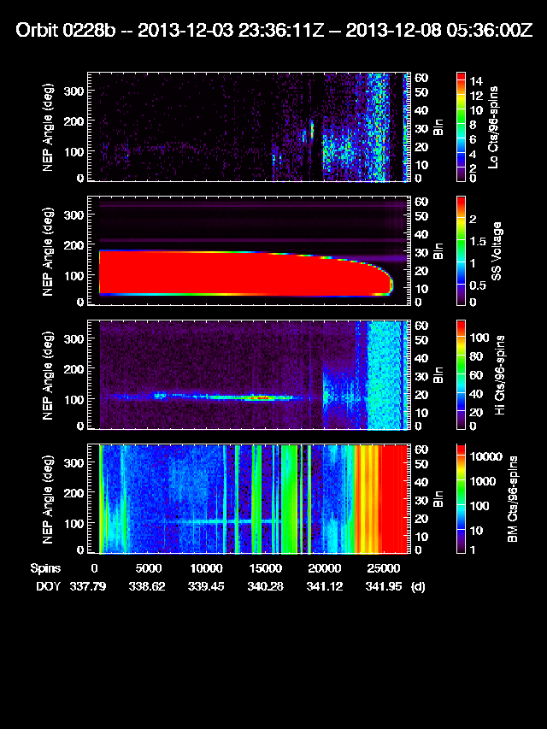
ISN 512spin Data Products (5/5)
Sample ISN Background goodtimes determination

Slide 14
ISN 512-Spin Data Release
ISN data for 2009 and 2010 have been released to the public.
ISN data for 2011 – 2014 have been released to the team and will be released to the public following the upcoming ApJS Special Section.
ISN data for 2015 have been generated and passed QA checks and will be released to the team.
  2015 data will be further validated during upcoming science investigations.

Slide 15
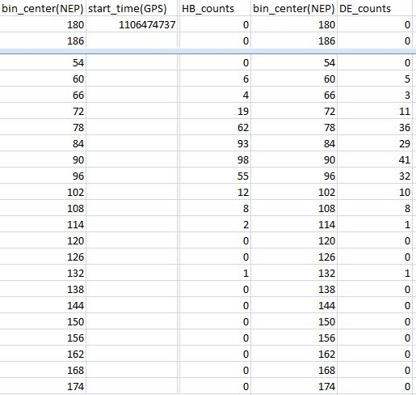
ISN Suppression Issues (1/2)
Some time periods show higher than expected direct event suppression in the ISN peak.
Direct event suppression
between 55-70% in the
peak.

Slide 16
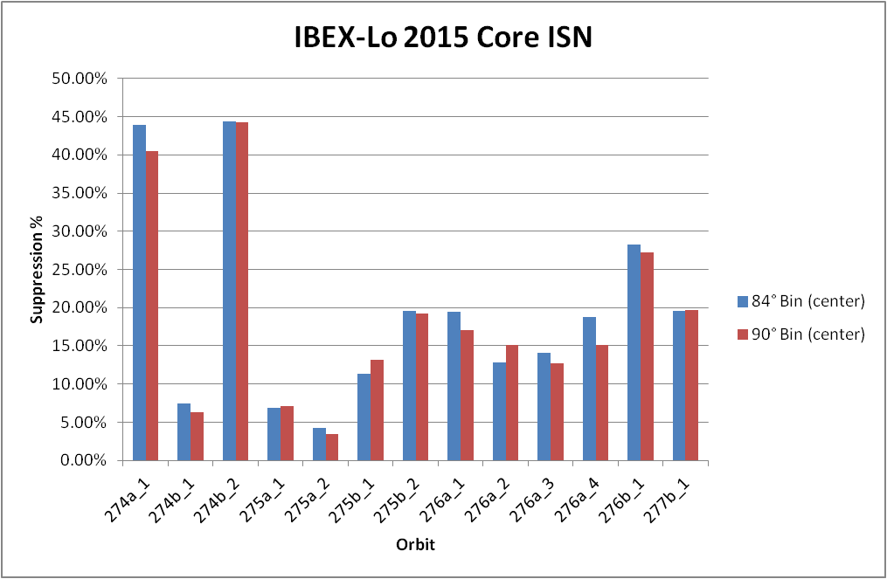
ISN Suppression Issues (2/2)
Some time periods show higher than expected direct event suppression.

